Slide 1

$$〈\text{QC}|\text{−}|\text{IL}⟩$$
First Steps in QC & QML
(Quantum Computing & Quantum Machine Learning)
Yossi Eliaz
March 2020

Slide 2
Outline
Quantum Computing: An Applied Approach by Jack D. Hidary
Python and the Google Colab cloud platform
Introduction (Chapters 1 and 2) :
Classical Bit, Qubit, NOT Gate, AND Gate, Classical Universality
Superposition, Entanglement and Reversibility
History of Computational Physics and Chemistry
Bits, qubits and operators (Chapter 3):
BIT vs QUBIT, vector presentation, red, blue quantum states
Universal set: CNOT, H, T
Types of quantum computers (Chapter 5)
Quantum programming with Cirq:
Implement NOT, CNOT, H, T
LaTeX to visualize quantum gates
Teleportation (Chapter 7)
ML + QML (Chapter 9 and TensorFlow Quantum):
What’re artificial intelligence, machine learning and deep learning
MNIST using classical TensorFlow
Quantum many hello worlds using TensorFlow Quantum (TFQ)

Slide 3
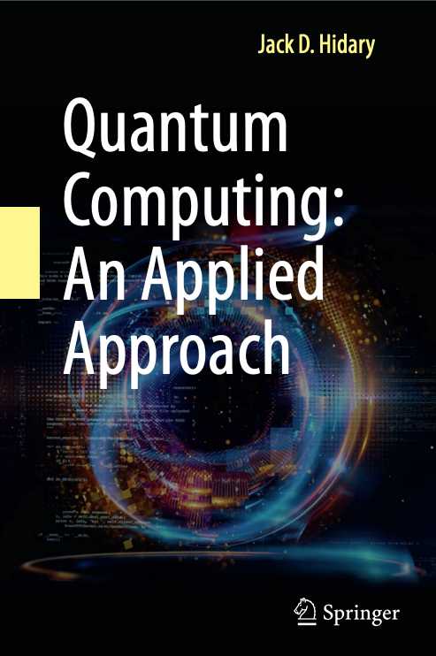
Quantum Computing: An Applied Approach Jack D. Hidary, 2019
https://github.com/JackHidary/quantumcomputingbook

Slide 4
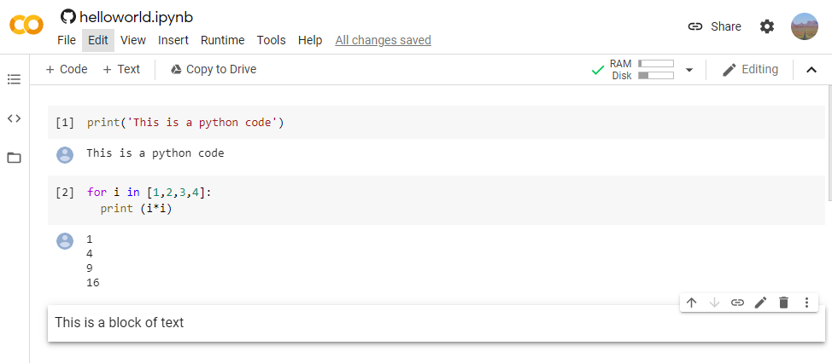
Google Colaboratory
Google Colab is a free cloud-based platform to execute Python code.
https://github.com/zozo123/QC-IL/blob/master/notebooks/helloworld.ipynb

Slide 5
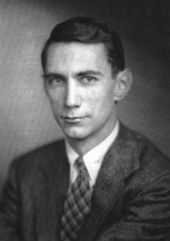
Introduction to classical and quantum computing
Claude Shannon redefined in 1948 rigorously three terms:
Information any type of message/data that can be communicated.
Bit is the minimal unit of information to distinguish between two states: On vs. Off, 0 vs. 1, or Red vs. Blue.
Entropy measures the number of possible values a set of bits can store.
Wikimedia

Slide 6



Binary operations store information by changing the values of bits
From now on, a bit is a rubber duck.
The duck can be colored as red (0) or blue (1). And by invest energy we can change its color multiple times.
The NOT gate allows to change the color of the duck
Bit
1
NOT
NOT Gate Truth Table
INPUT | OUTPUT
0 | 1
1 | 0
0
1
NOT
1
0

Slide 7
Binary operators with two input bits
AND gate outputs 1 if and only if all inputs are 1.
The {AND, NOT} is universal for classical computing.
Using NOT and AND gates we can represent any binary gate.
AND Gate Truth Table
INPUTS |  | OUTPUT
X | Y
0 | 0 | 0
0 | 1 | 0
1 | 0 | 0
1 | 1 | 1
NOT Gate Truth Table
INPUT | OUTPUT
0 | 1
1 | 0

Slide 8

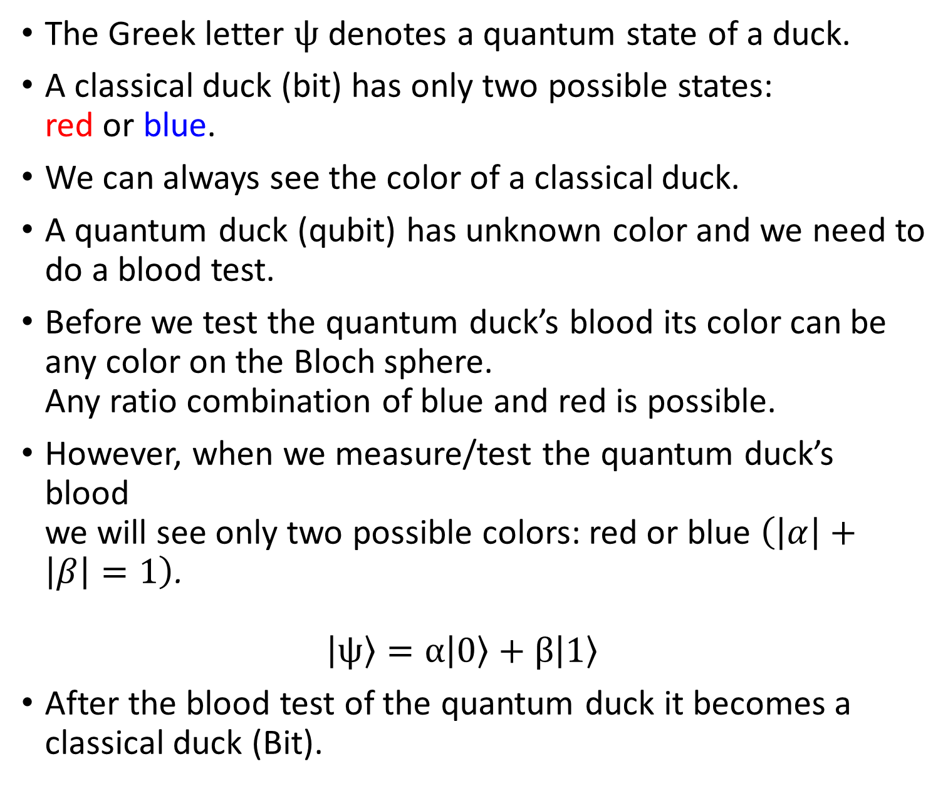


Qubit is a quantum bit
The Greek letter $ψ$ denotes a quantum state of a duck.
A classical duck (bit) has only two possible states: red or blue.
We can always see the color of a classical duck.
A quantum duck (qubit) has unknown color and we need to do a blood test.
Before we test the quantum duck’s blood its color can be any color on the Bloch sphere. Any ratio combination of blue and red is possible.
However, when we measure/test the quantum duck’s blood we will see only two possible colors: red or blue $\left(\left|α\right|+\left|β\right|=1\right)$. $\left|ψ\right\rangle =α\left|0\right\rangle +β\left|1\right\rangle$
After the blood test of the quantum duck it becomes a classical duck (Bit).
Qubit
1
$$|1⟩$$
$$θ$$
$$|0⟩$$
0

Slide 9
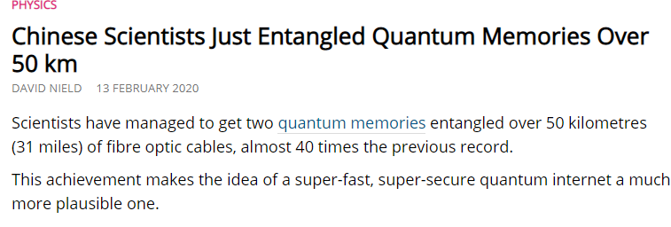
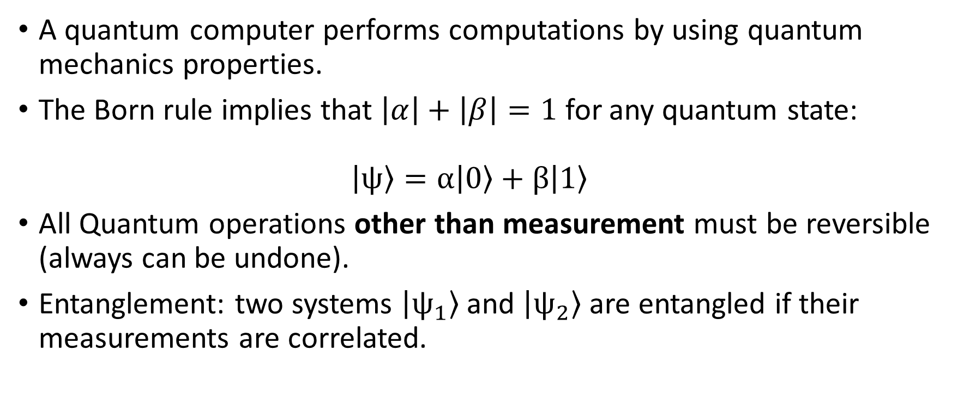
Quantum
A quantum computer performs computations by using quantum mechanics properties.
The Born rule implies that $\left|α\right|+\left|β\right|=1$ for any quantum state: $\left|ψ\right\rangle =α\left|0\right\rangle +β\left|1\right\rangle$
All Quantum operations other than measurement must be reversible (always can be undone).
Entanglement: two systems $\left|ψ_{1}\right\rangle$ and $\left|ψ_{2}\right\rangle$ are entangled if their measurements are correlated.

Slide 10
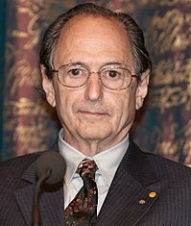
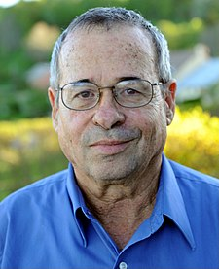
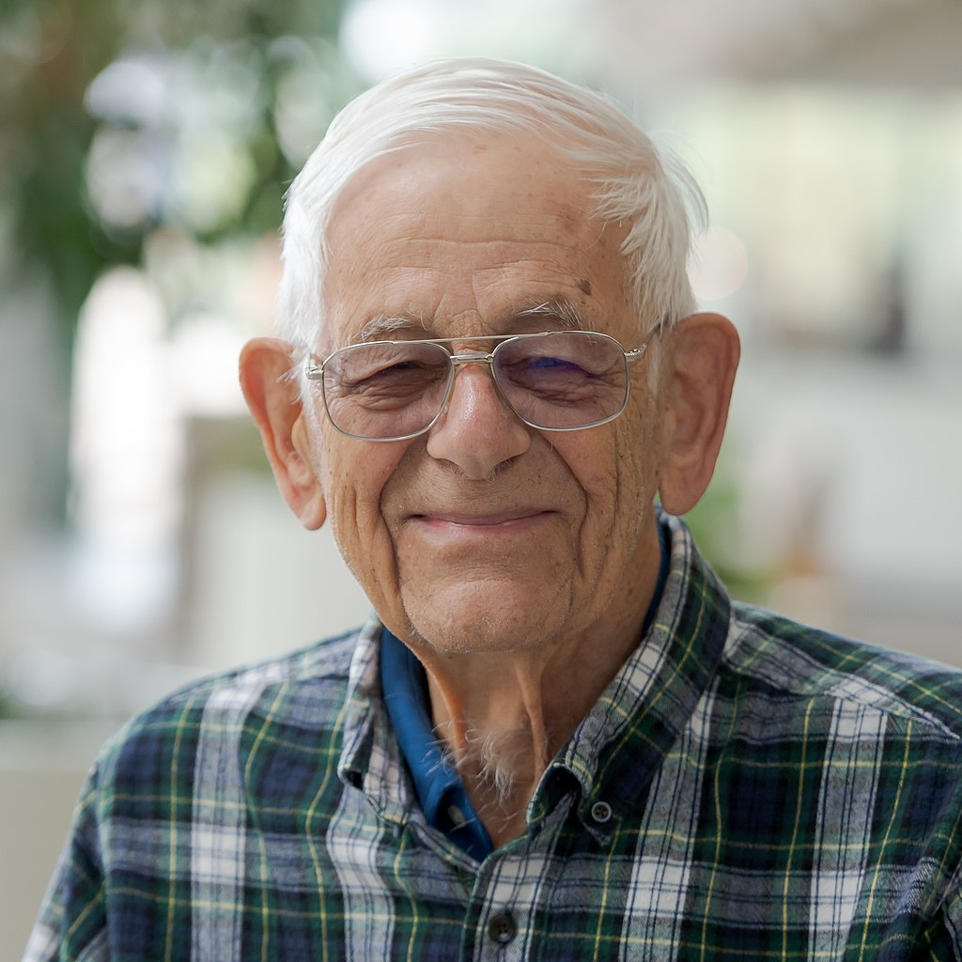
History of computational physics and chemistry
1975: Michael Levitt & Arieh Warshel published in Nature:
“Computer simulation of protein folding”
1979: Paul Benioff submit the paper:
“The computer as a physical system: A microscopic quantum mechanical Hamiltonian model of computers as represented by Turing machines”
1981: Richard Feynman gives the lecture:
“Simulating (Quantum) Physics with Computers”
Wikimedia
Wikimedia

Slide 11
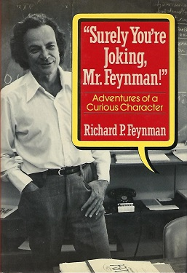

Richard Feynman
Nobel Prize in Physics in 1965
Lectures on Project Tuva by Microsoft: "Best science lectures I've ever seen.“ Bill Gates
Free online version of his lectures’ book
The Faraday Project (Lectures with Hebrew subtitles)
Explained why it’s intractable using a classical computer to simulate quantum mechanics.

Slide 12
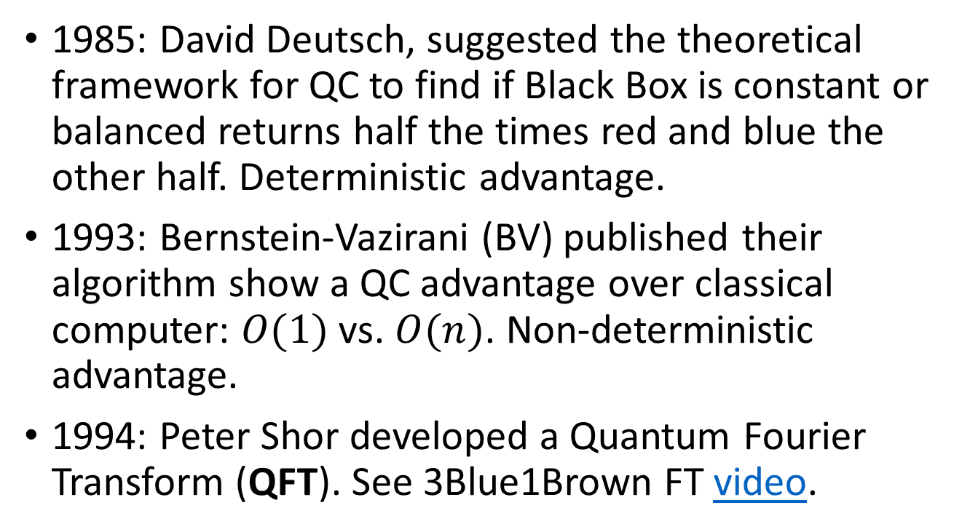
Later history of quantum computing (QC)
1985: David Deutsch, suggested the theoretical framework for QC to find if Black Box is constant or balanced returns half the times red and blue the other half. Deterministic advantage.
1993: Bernstein-Vazirani (BV) published their algorithm show a QC advantage over classical computer: $O(1)$ vs. $O(n)$. Non-deterministic advantage.
1994: Peter Shor developed a Quantum Fourier Transform (QFT). See 3Blue1Brown FT video.
Qubit
Black Box
Qubit

Slide 13
Fast Fourier Transform (FFT)
Notebook

Slide 14
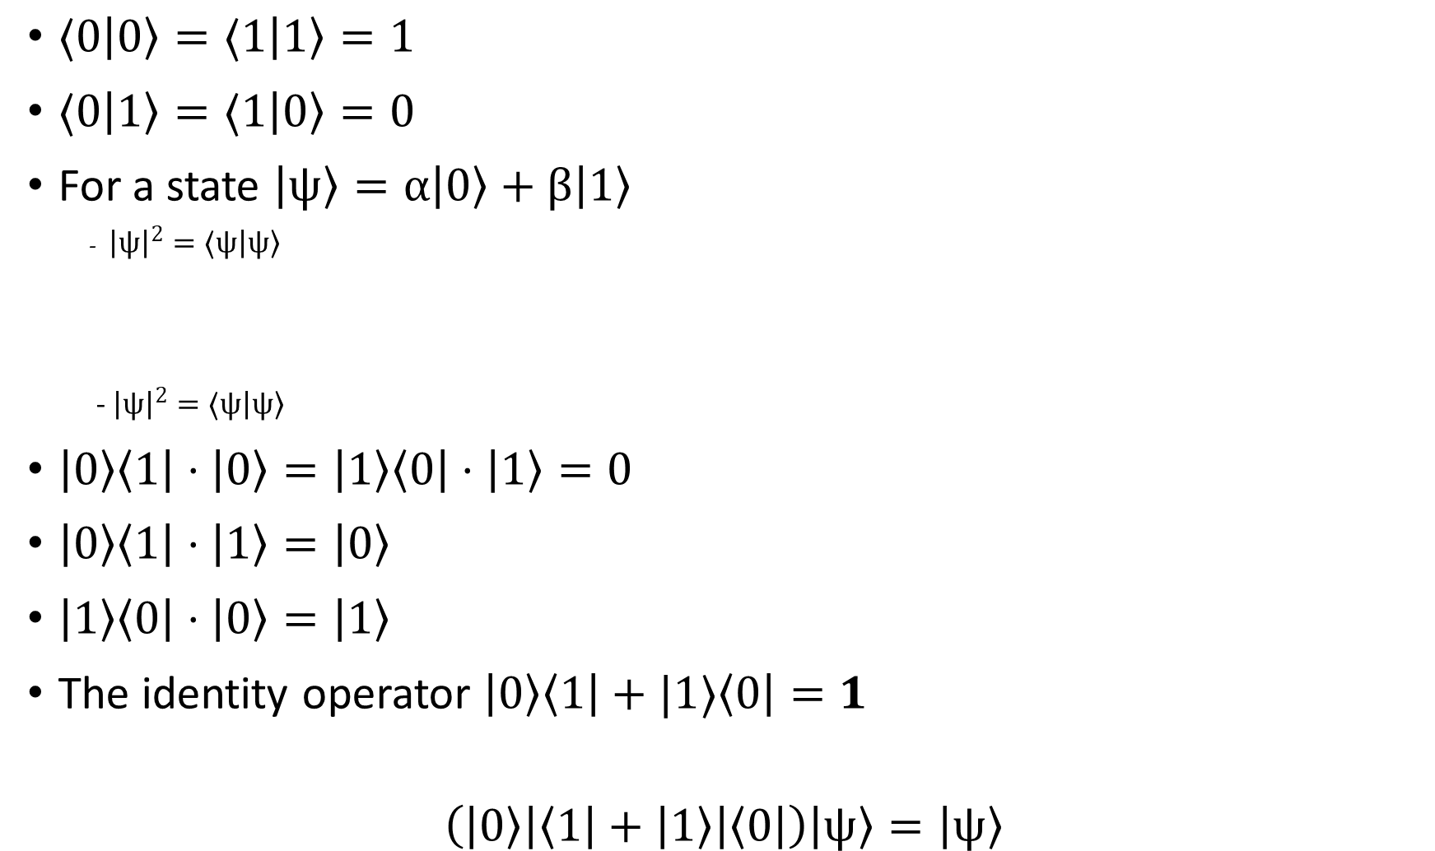
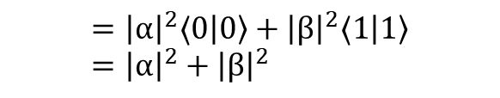
Quantum Operators on Qubits
Bits, qubits and operators (Chapter 3):
BIT vs QUBIT, vector presentation, red, blue quantum states
Universal set: CNOT, H, T
$⟨0\left|0\right\rangle =⟨1\left|1\right\rangle =1$
$⟨0\left|1\right\rangle =⟨1\left|0\right\rangle =0$
For a state $\left|ψ\right\rangle =α\left|0\right\rangle +β\left|1\right\rangle$
- ${\left|ψ\right|}^{2}=⟨ψ\left|ψ\right\rangle$
- ${\left|ψ\right|}^{2}=⟨ψ\left|ψ\right\rangle$
$\left|0\right\rangle \left\langle 1\right|⋅\left|0\right\rangle =\left|1\right\rangle \left\langle 0\right|⋅\left|1\right\rangle =0$
$\left|0\right\rangle \left\langle 1\right|⋅\left|1\right\rangle =\left|0\right\rangle$
$\left|1\right\rangle \left\langle 0\right|⋅\left|0\right\rangle =\left|1\right\rangle$
The identity operator $\left|0\right\rangle \left\langle 1\right|+|1⟩\left\langle 0\right|=1$
$$\left(\left|0\right\rangle \left|\left\langle 1\right|+\left|1\right\rangle \right|\left\langle 0\right|\right)\left|ψ\right\rangle =\left|ψ\right\rangle$$
$$= ({α^{⁕}}^{ }\left\langle 0 | +{β^{⁕}}^{ }\left\langle 1\right|\right)⋅ \left(α\left|0\right\rangle +β\left|1\right\rangle \right)$$
$$={\left|α\right|}^{2}⟨0\left|0\right\rangle +{\left|β\right|}^{2}⟨1\left|1\right\rangle ={\left|α\right|}^{2}+{\left|β\right|}^{2}$$

Slide 15

Gates
To write as $\left|01\right\rangle →|11⟩$

Slide 16
Chap 5
Types of quantum computers (Chapter 5)

Slide 17
Quantum programming with Cirq:
Implement NOT, CNOT, H, T
LaTeX to visualize quantum gates

Slide 18
Teleportation (Chapter 7)

Slide 19
ML + QML (Chapter 9 and TensorFlow Quantum):
What’re artificial intelligence, machine learning and deep learning
MNIST using classical TensorFlow
Quantum many hello worlds using TensorFlow Quantum (TFQ)

Slide 20






$$|1⟩$$
1
$$|A⟩$$
1
$$θ$$
$$\left|ψ\right\rangle =α\left|0\right\rangle +β\left|1\right\rangle$$
0
$$|0⟩$$
A

Slide 21
https://towardsdatascience.com/exploring-tensorflow-quantum-googles-new-framework-for-creating-quantum-machine-learning-models-3af27ba916e9?gi=7d8932eba7ad
Code introductory talk https://www.youtube.com/watch?v=F_Riqjdh2oM

Slide 22
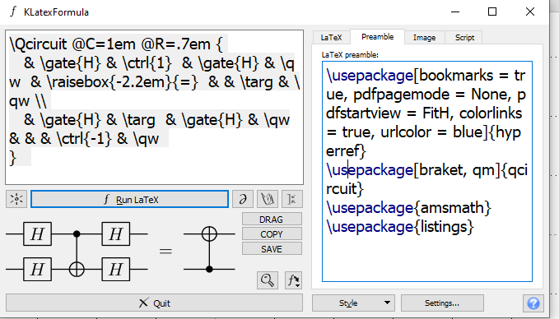
\Qcircuit @C=1em @R=.7em {
& \gate{H} & \ctrl{1} & \gate{H} & \qw & \raisebox{-2.2em}{=} & & \targ & \qw \\
& \gate{H} & \targ & \gate{H} & \qw & & & \ctrl{-1} & \qw
}
\usepackage[bookmarks = true, pdfpagemode = None, pdfstartview = FitH, colorlinks = true, urlcolor = blue]{hyperref}
\usepackage[braket, qm]{qcircuit}
\usepackage{amsmath}
\usepackage{listings}

Slide 23
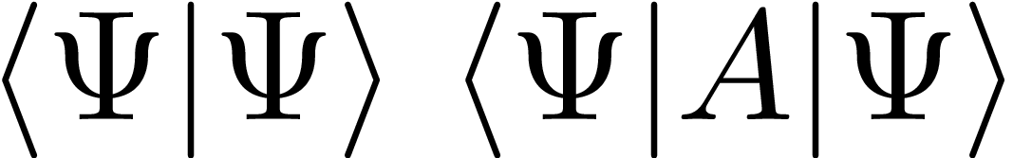
\bra{\Psi}\ket{\Psi} \expval{A}{\Psi}
\usepackage[bookmarks = true, pdfpagemode = None, pdfstartview = FitH, colorlinks = true, urlcolor = blue]{hyperref}
\usepackage[braket, qm]{qcircuit}
\usepackage{amsmath}
\usepackage{listings}
\usepackage{braket}
\usepackage{physics}

